Slide 1


V. T cell response
by Bruno Lemaitre,
Ecole Polytechnique Fédérale de Lausanne
Web: http://ghi.epfl.ch

Slide 2
Introduction

Slide 3
Questions
Which signals activate T lymphocytes?
How are the few naïve T cells specific for any microbe converted into the large number of effector T cells with specialized functions?

Slide 4
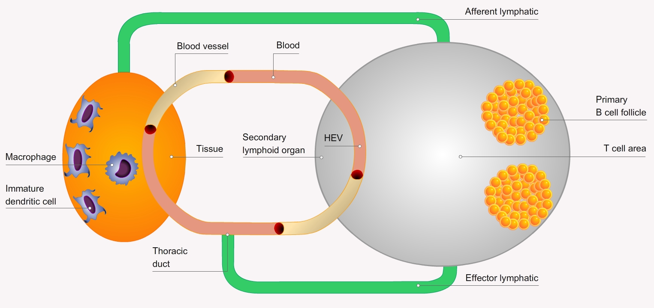
Role and Phases of T cell response
T cell immune responses serve three purposes:
eliminate intracellular microbes, such as viruses, that infect and replicate inside various cell types, including non-phagocytic cells
defend against intracellular microbes that evolved to survive within phagocytes
assist the development of B cell responses, activate macrophages, cmast cells, and eosinophils
T cell immune responses can be divided into three phases:
Induction phase
Effector phase
Contraction phase

Slide 5
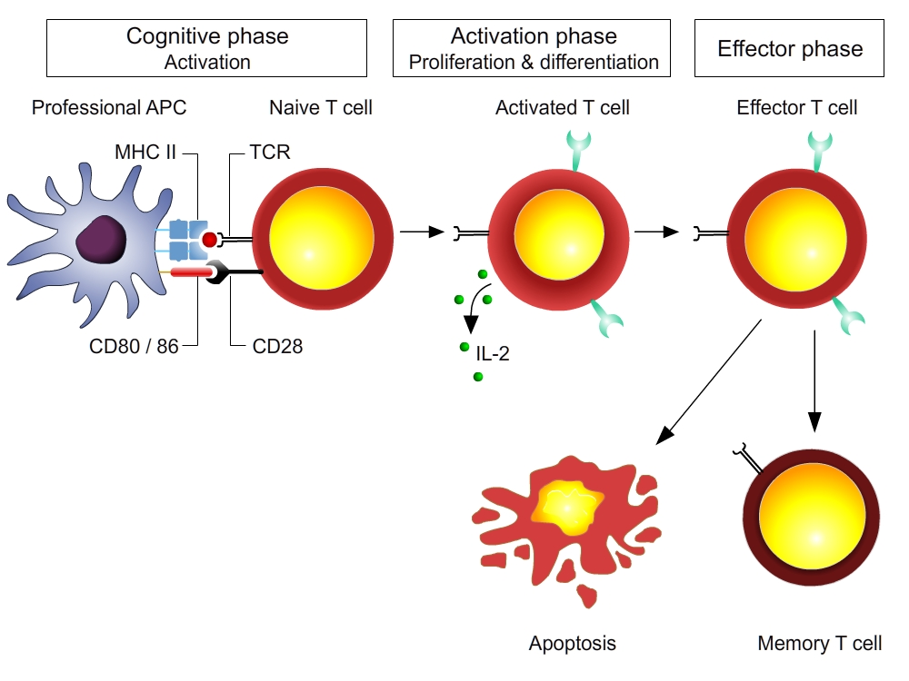
Life of a mature T cell after contact with antigen

Slide 6
Outline
V-A T cell activation by APCs
V-B Consequences of T cell activation
V-C T cell differentiation (Th1 / Th2)

Slide 7
V-1
T cell activation by APCs
The 2 signals
The immunological synapse
TCR activation by superantigens
Role of co-stimulation and cell adhesion
Specific features of CD8 T cell activation

Slide 8
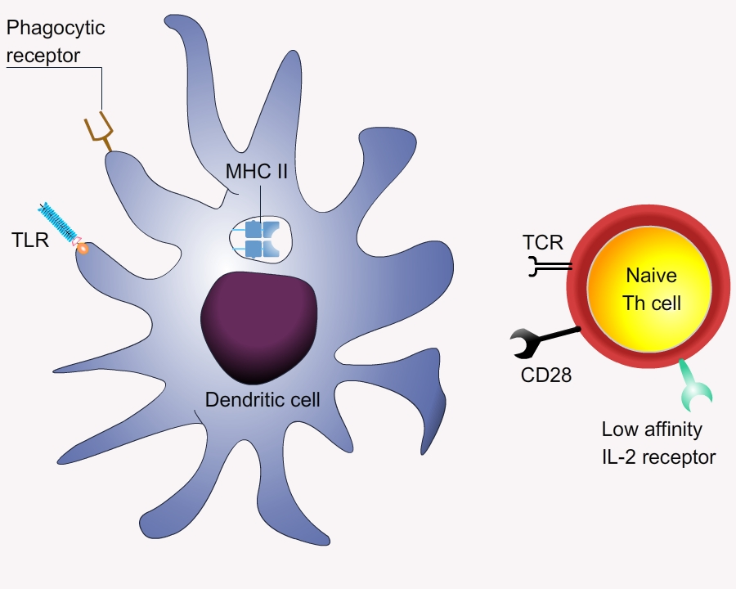
The 2 signals
T-cell activation typically requires two events:
TCR engagement: antigen recognition by T cell, a specific event that involves the ligation of the TCR/CD3 complex with antigen fragments bound to MHC molecules on APCs.
Co-stimulation: antigen-nonspecific interactions between co-stimulatory molecules and their ligands on the APC and the T cell.

Slide 9
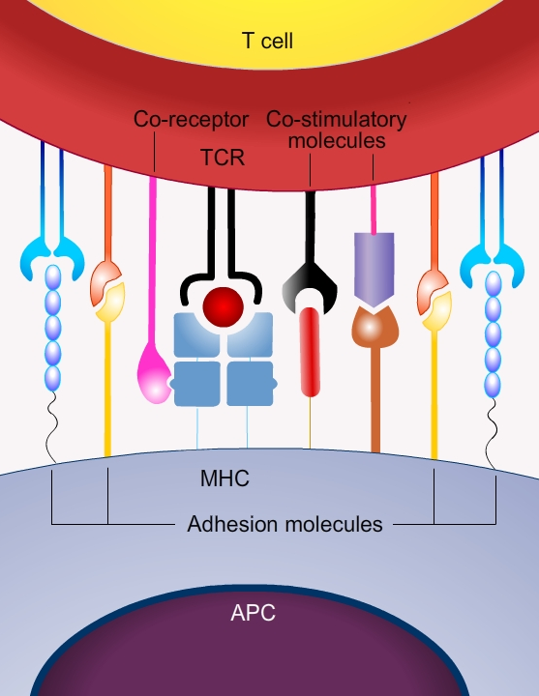
T cell / APC interactions
Initial contacts between APCs and T cells are antigen-independent and mediated by cell-adhesion molecules (e.g. LFA1 on T cells and ICAM on APCs)
Upon antigen recognition
  interactions occur between the TCR and MHC
  specialized junctions form at the cell surface, the immunological synapses (IS)
  An IS contains
    the TCR/MHC-peptide complex
    the co-receptors (CD4/CD8)
    the co-stimulatory molecules
    peripheral cell adhesion molecules
  An IS is maintained for up to 48 h enabling the prolonged signal transduction required for T cell activation

Slide 10
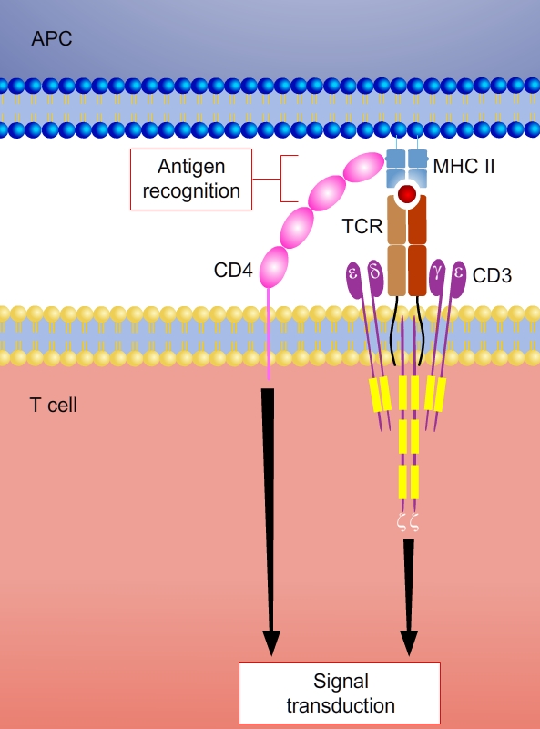
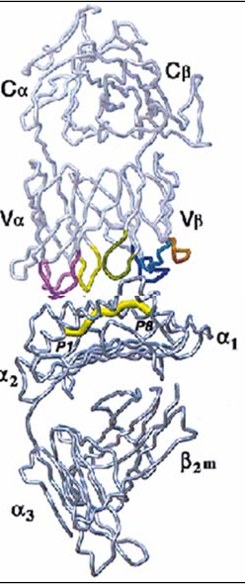
TCR / antigen interactions
The primary activation signal is induced when specific TCRs on naïve T cells recognize antigenic peptides bound to the MHC/peptide complex on APCs.
Each T cell needs to engage antigen for a long period, at least several minutes, or multiple times to generate enough signals to initiate a response.
  Structure of the TCR
  The TCR
    α (or δ) chain
    β (or γ) chain
  CD3: the signal transduction complex
    γ chain
    δ chain heterodimers
    ε chain
    ζ chain homodimer

Slide 11
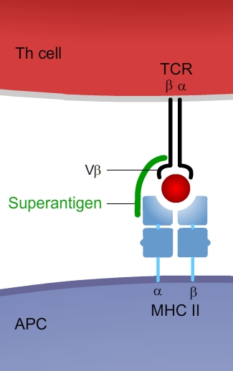
TCR-activation by superantigens
Superantigens
viral or bacterial proteins that bind simultaneously to the TCR V chain and to the a chain of an MHC class II molecule. This induces crosslinking of TCR & MHCII resulting in T cell activation and proliferation.
e.g. staphylococcal enterotoxins (SEA, SEB, SEC, SED & SEE), Toxic shock syndrome toxin I (TSST-1)
do not induce adaptive responses, but trigger a massive burst of cytokines that may cause fever, systemic toxicity & immune suppression
e.g. severe food poisoning, toxic shock syndrome
N.B. Polyclonal activators are often used as experimental tools to study T cell responses and in clinical settings to test for T cell function.

Slide 12
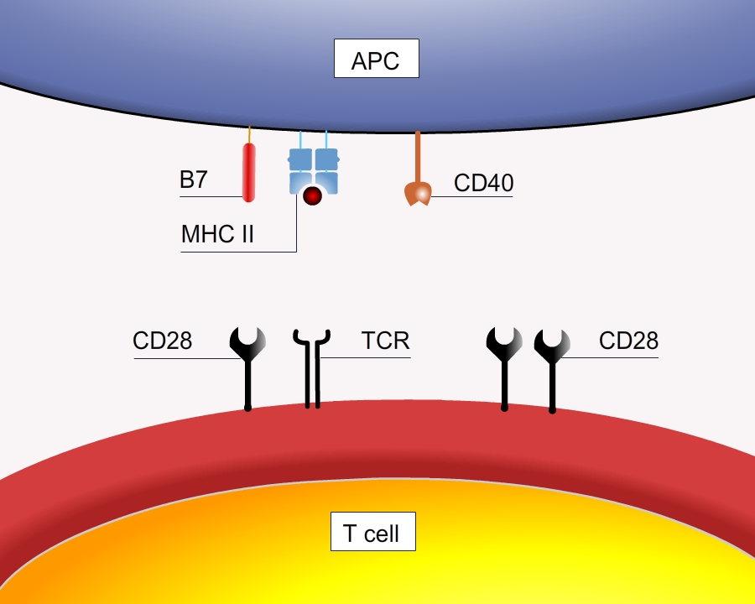
Co-stimulatory molecules
There are two major classes of co-stimulators:
CD80 (or B7-1) and CD86 (or B7-2)
Belong to Ig superfamily
interact with CD28 or CTLA4 on T cells
provide the major co-stimulus to resting naïve T cells by reducing the threshold for TCR signalling
CD40/CD40L
Belong to tumor necrosis factor receptor (TNF-R) superfamily
CD40 (on APCs) induces APCs to produce more CD80/CD86 co-stimulators and IL-12
CD40L (on T cells) determines the capacity of T cells to interact with other cells

Slide 13
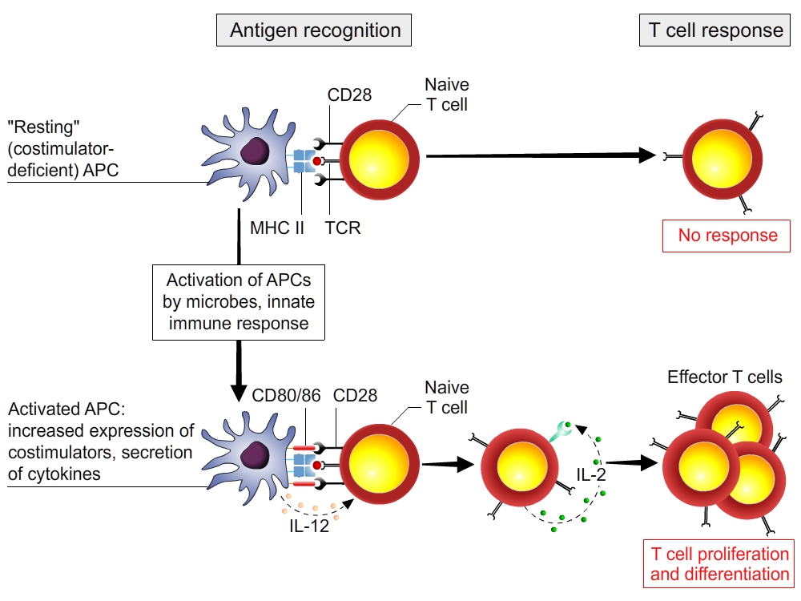
The role of co-stimulation
Signal 1 in the absence of signal 2 causes antigen-specific T cell unresponsiveness. The T cell is unable to produce IL-2 and therefore is unable to proliferate or be clonally selected.
The role of co-stimulation is illustrated by the effect of adjuvants (that activate co-stimulatory molecules). It ensures that T cells are activated in an infectious context. Understanding the biology of co-stimulators is essential in immunotherapies and vaccine development.

Slide 14
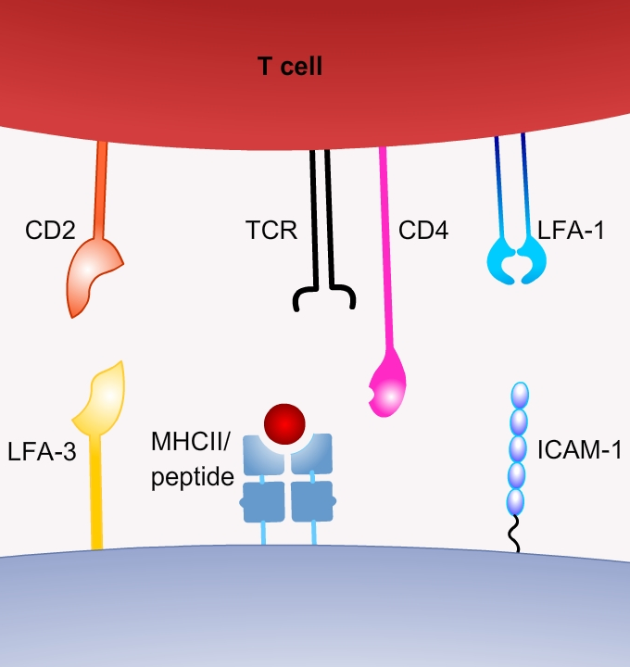
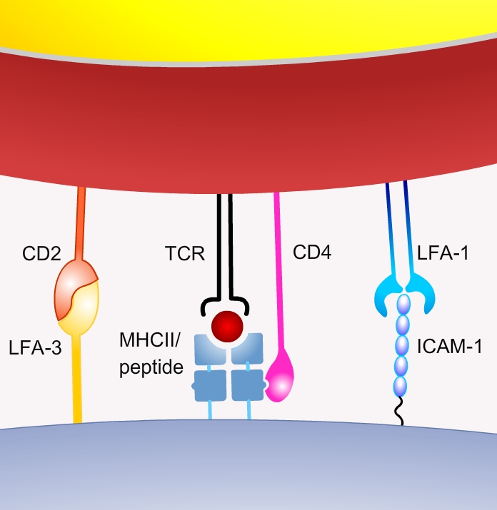
Adhesion molecules
To induce a productive response, the binding of T cells to APCs must be stabilized for a sufficiently long period to achieve the necessary signalling threshold. This is performed by adhesion molecules on the T cells whose ligands are expressed on APCs.
The most important of these adhesion molecules belong to the family of heterodimeric (two-chain) proteins called integrins (e.g. LFA-1).
Signals delivered by chemokines and antigen recognition increase integrin affinity and clustering.
Leukocyte function-associated antigen-1
(LFA-1)
Intercellular adhesion molecule-1 (ICAM-1)

Slide 15
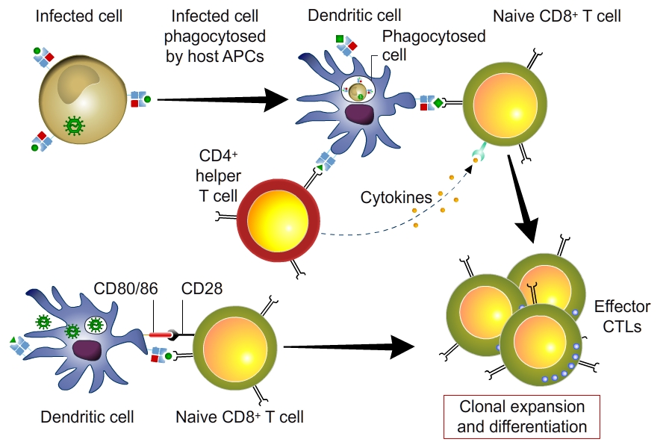
Specific features of CD8+ T cell activation
An APC which has phagocytized an infected cell activates both CD8+ and CD4+ T cells
An infected APC can activate CD8+ T cells
Activation of CD8 T cells: two modes of antigen presentation.
APCs ingest infected cells and present microbial antigens to CD8+ T cells and to CD4+ helper T cells. The helper T cells then produce cytokines that stimulate the expansion and differentiation of the CD8+ T cells. This is mainly mediated trough a feedback activation from CD4 T cell to the DC that become more prone to stimulate the CD8 T cell.
If the APC harbors a cytoplasmic microbe, CD8+ T cells recognize class I MHC-associated peptides and receive costimulatory signals.

Slide 16
Specific features of CD8+ T cell activation
The activation of CD8+ T cells is stimulated by recognition of class I MHC-associated peptides and requires costimulation and/or helper T cells.
Specific features of CD8+ T cell activation:
initiation often requires that the cytoplasmic antigen from one cell be cross-presented by dendritic cells
differentiation into CTLs may require the concomitant activation of CD4+ helper T cells.
When virus-infected cells are ingested by dendritic cells and the viral antigens are cross-presented by the APCs, the same APC presents antigens from the cytosol on class I MHC and from vesicles on class II MHC molecules. Thus, both CD8+ T cells and CD4+ T cells specific for viral antigens are activated together. The CD4+ T cells produce cytokines that activate the CD8+ T cells and stimulate the DC to produce more CD80/CD86.
Note: This requirement for helper T cells in CD8+ T cell responses is the likely explanation for the defective CTL responses to many viruses in patients infected with the human immunodeficiency virus (HIV), which kills CD4+ but not CD8+ T cells.

Slide 17
Conclusions | T cell activation
T lymphocytes respond in sequential phases: recognition of cell-associated microbial proteins by naïve T cells, expansion of the antigen-specific clones by proliferation, and differentiation of some of the progeny into effector cells and memory cells.
Dendritic cells and T cells interact by forming an immunological synapse involving
  the TCR with its co-receptors (CD4/CD8)
  co-stimulatory receptors
  adhesion molecules
Two types of co-stimulation
  Expression of CD80/86 on DCs provides signal 2 (‘Danger’)
  Expression of CD40L on T cells increases co-stimulatory signals on DCs (feedback)
Two mechanisms of activation of CD8 T cells by DCs
  An infected DC can activate CD8+ T cells in the absence of CD4+ T cells
  A DC which has phagocytized an infected cell can activate CD4+ T cells and CD8+ T cells by cross-presentation. CD8+ T cell activation requires signals from CD4+ T cells through the production of cytokines and positive feedback on DCs (CD40L-CD40)

Slide 18
V-2
Consequences of T cell activation
Signal transduction
Cytokine production
Clonal expansion

Slide 19
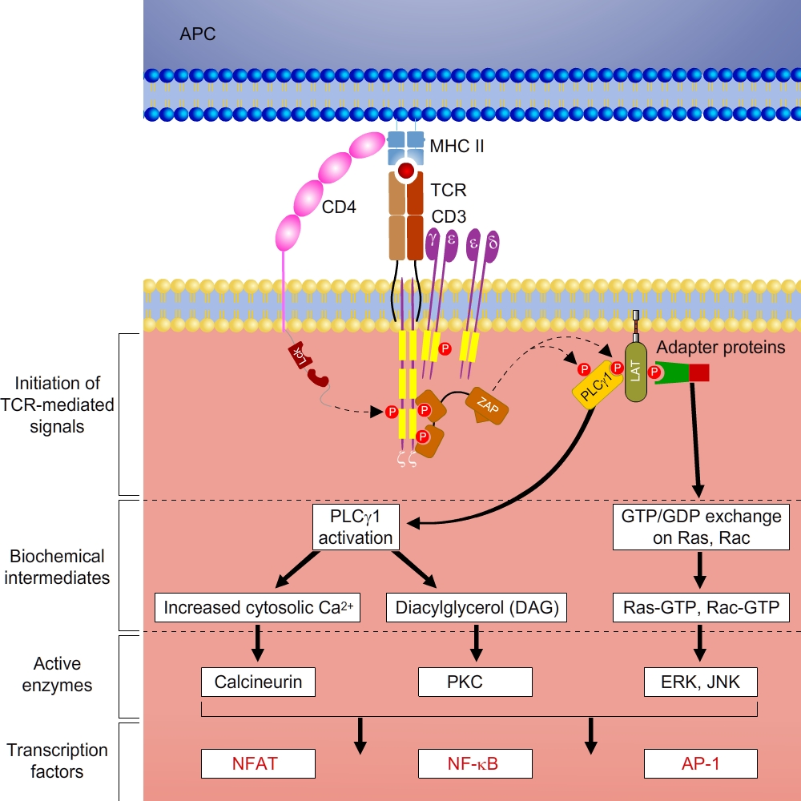
Signal transduction
Antigen recognition by T cells induces early signaling events, which include tyrosine phosphorylation of molecules of the TCR complex and the recruitment of adapter proteins to the site of T cell antigen recognition.
These early events lead to the activation of several biochemical intermediates, which in turn activate transcription factors.
AP-1, activating protein-1
APC, antigen-presenting cell
GTP/GDP, guanosine triphosphate/diphosphate
ITAM, immunoreceptor tyrosine-based activation motif
NFAT, nuclear factor of activated T cells
PKC, protein kinase C
PLCγ1: γ1 isoform of phosphatidylinositol-specific phospholipase C
TCR, T cell receptor

Slide 20
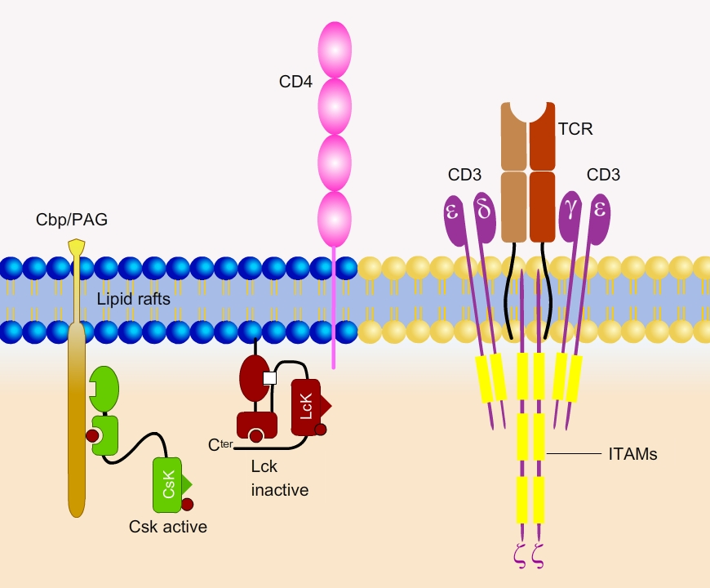
Signal transduction: initial steps
Engagement of the TCR triggers 4 distinct transduction pathways leading to
T cell proliferation
  MAP kinase pathway
T cell differentiation
  NFAT pathway
  NFκB pathways
T cell motility
  Rho/CDC42 pathway

Slide 21
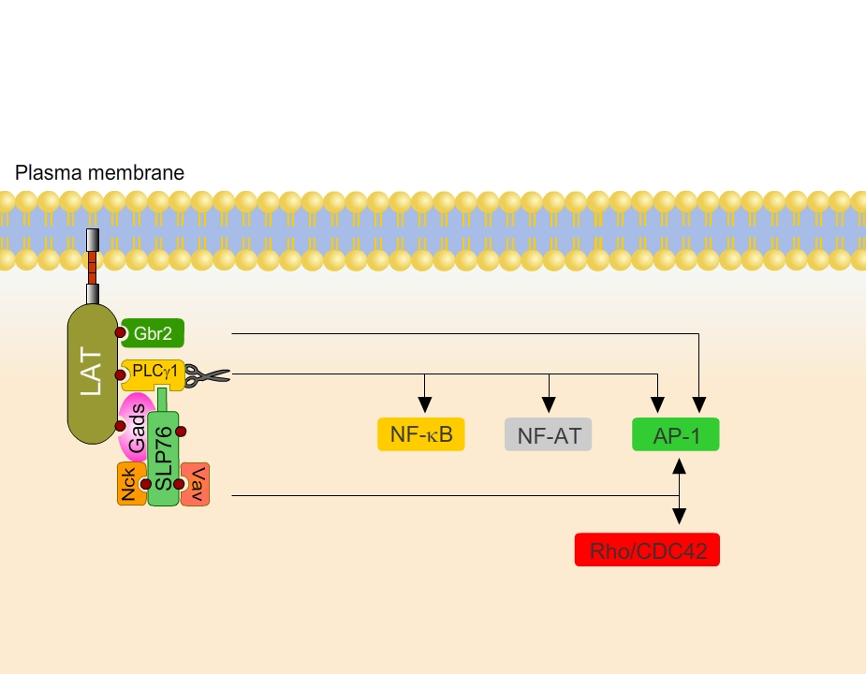
Signal transduction: the NFκB pathway
Engagement of the TCR triggers 4 distinct transduction pathways leading to
T cell proliferation
  MAP kinase pathway
T cell differentiation
  NFAT pathway
  NFκB pathways
T cell motility
  Rho/CDC42 pathway

Slide 22
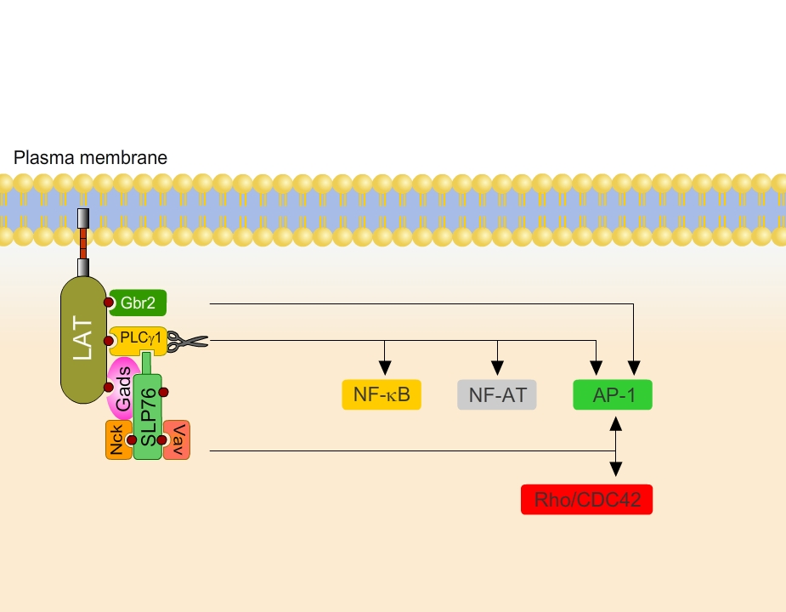
Signal transduction: the NFAT pathway
Engagement of the TCR triggers 4 distinct transduction pathways leading to
T cell proliferation
  MAP kinase pathway
T cell differentiation
  NFAT pathway
  NFκB pathways
T cell motility
  Rho/CDC42 pathway

Slide 23
Cytokine production
In response to antigens and co-stimulators, T lymphocytes, especially CD4+ T cells, rapidly secrete several different cytokines that have diverse activities.
Cytokine | Source | Target | Effects
IL-2 | CD4+ and CD8+ T cells | Effector and regulatory T cells | Survival, proliferation, differentiation
IL-4 | CD4+ T cells, mast cells | B cells | Class switch to IgE
IL-5 | CD4+ T cells, mast cells | Eosinophils | Activation
IFN-γ | CD4+ and CD8+ T cells, NK cells | Macrophages | Activation
TGF-β | CD4+ T cells, many other cell types | T cells | Inhibition, differentiation of regulatory T cells
IL, interleukin; IFN, Interferon; TGF, tissue growth factor

Slide 24
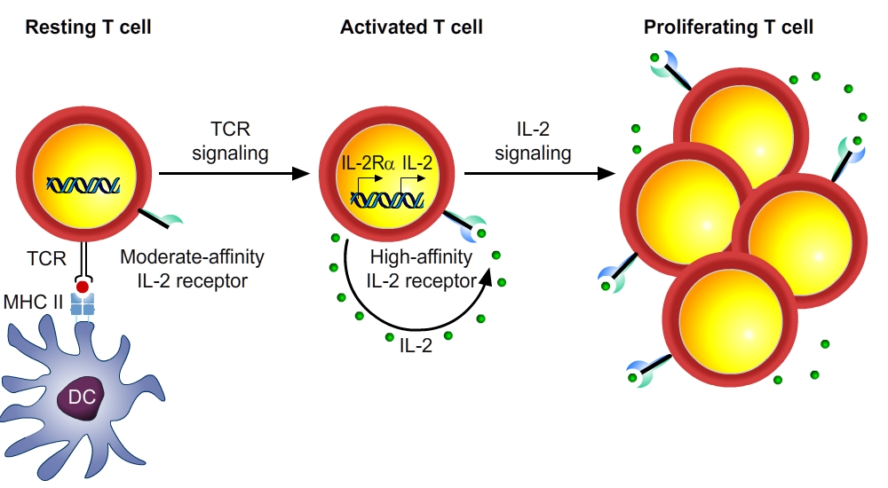
Clonal expansion (1)
T cell are in resting state (G0) when leaving the thymus.
Naïve cells recirculate between blood and lymph system every 12-24 hours
Activation of T cells results in primary response 2-7 days after activation:
  Blast formation
  Repeated rounds of cell division
The key molecule that regulates T cell proliferation is the soluble cytokine IL-2.
IL-2 produced by activated T cells induces expansion through interaction with its receptor (IL-2R)
  autocrine pathway (promoting its own clonal expansion)
  paracrine pathway (inducing proliferation of other IL-2R+ cells).

Slide 25
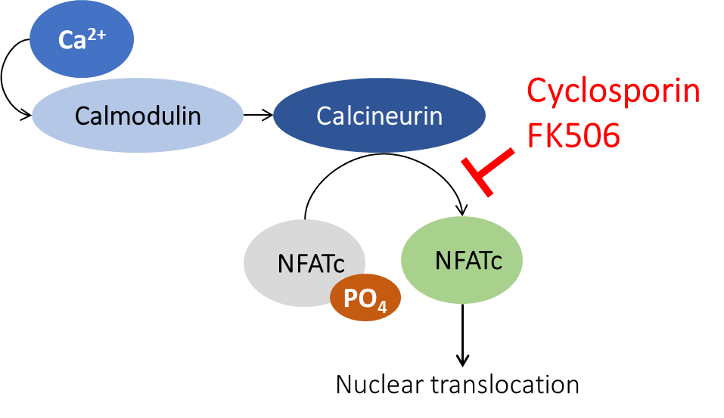
Importance of IL-2
Immunosuppressive drugs (e.g. used for organ transplantation) illustrate the importance of IL-2 in immune responses.
Cyclosporin & FK506 inhibit IL-2 by disrupting TcR signalling by inhibiting the action of calcineurin.

Slide 26
Clonal expansion (2)
Magnitude of clonal expansion differs between CD8+ and CD4+ T cells:
  CD8+ T cells specific for a virus: 100,000-fold increase (from 1/10⁵ - 1/10⁶ to 10% - 20% of all lymphocytes, with a doubling time of about 6 hours)
  CD4+ T cells: 100- to 1000-fold increase
Difference in expansion reflects difference in function: CD8+ CTLs are effector cells that kill infected cells (direct action), while CD4+ effector cells secrete cytokines that activate many other effector cells (amplified action).
No detectable increase in "bystander" cells that do not recognize the invading microbe
Majority of the expanded clones are specific for only a few (<5) immunodominant peptides of the invading microbe

Slide 27
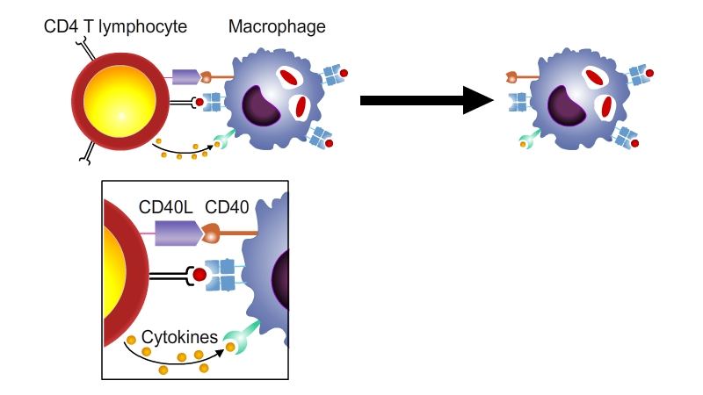
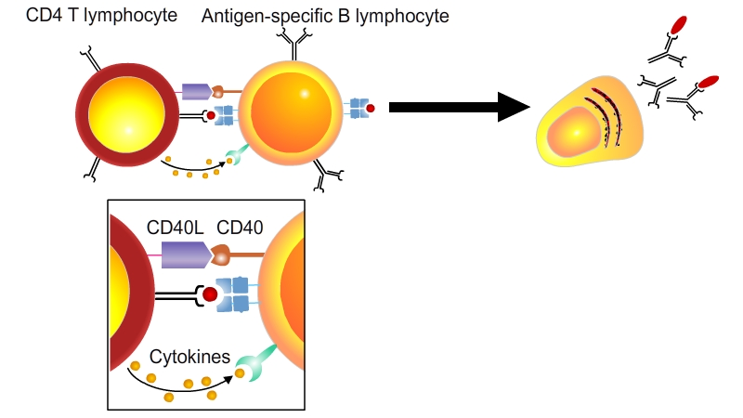
Role of CD40 ligand (CD40L)
CD4+ helper T cells differentiate into effector cells that respond to antigen by producing surface molecules and cytokines that function to activate phagocytes and B lymphocytes.
The most important cell surface protein of CD4+ T cells is CD40 ligand (CD40L), expressed in response to antigen recognition and costimulation.
CD40L binds to its receptor CD40, which is expressed on macrophages, B cells, and dendritic cells. Engagement of CD40 activates these cells, and thus CD40L is an important participant in the activation of macrophages and B lymphocytes by helper T cells

Slide 28
Conclusions | Consequences of T cell activation
T cell activation by DCs starts complex signalling pathways inducing T cell proliferation and T cell differentiation.
A key molecule that regulates T cell proliferation is the soluble cytokine IL-2.
Immunosuppressive drugs used in transplantation target the NFAT pathway involved in IL-2 production.
The CD40L gene expressed in differentiated CD4+ T allows T cells to interact with macrophages, B lymphocytes, and dendritic cells, which express CD40.
During an adaptive immune response a few clones of T cells recognizing immunodominant peptides of the invading microbe expand massively.

Slide 29
V-C
T cell differentiation (Th1 / Th2)
Functions of Th1 and Th2 cells
Th1 / Th2 cell differentiation

Slide 30
T cell differentiation: Th1/Th2
The immune system responds very differently to different microbes.
Examples:
Intracellular microbes such as mycobacteria are ingested by phagocytes but resist intracellular killing. The adaptive immune response results in the activation of the phagocytes to kill the ingested microbes.
Helminthic parasites are too large to be phagocytosed, and the immune response to helminths is dominated by the production of immunoglobulin E (IgE) antibodies and the activation of eosinophils.

Slide 31
T cell differentiation: Th1/Th2
Macrophages, phagocytosis
IgE, eosinophils
CD4+ T cells
Both types of immune responses are dependent on CD4+ helper T cells, but for many years it was not clear how the CD4+ helper cells are able to stimulate such distinct immune effector mechanisms.
This puzzle was solved by the discovery of functionally distinct subpopulations of CD4 effector T cells that are distinguished by the cytokines they produce.
The subsets that were defined first are called Th1 cells and Th2 cells (type 1 or type 2 helper T cells); more recently, a third population has been identified, called Th17 cells because their signature cytokine is IL-17. Regulatory T (T Reg) cells are yet another subset of CD4 T cells; their role is to suppress immune responses.

Slide 32
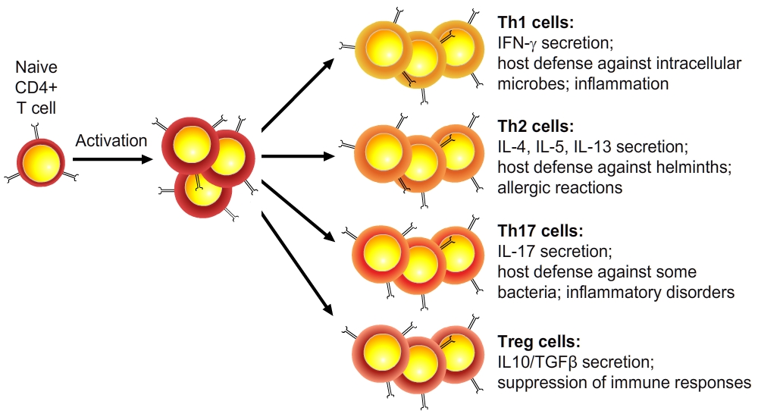
Development and characteristics of subsets of CD4+ helper T lymphocytes
Characteristics | Th1 | Th2
Cytokines IFN-γ, IL-2, TNF IL-4, IL-5, IL-13 IL-10 IL-3, GM-CSF | +++ - +/- ++ | - +++ ++ ++
Antibody isotypes stimulated | IgG2a (mouse) | IgE, IgG1 (mouse)/IgG4 (humans)
Macrophage activation to kill microbes | +++ | -
Note that many helper T cells are not readily classified into these distinct and polarized subsets.
GM-CSF, granulocyte-macrophage colony-stimulating factor; IFN, interferon; Ig, immunoglobulin; IL, interleukin; TNF, tumor necrosis factor.

Slide 33
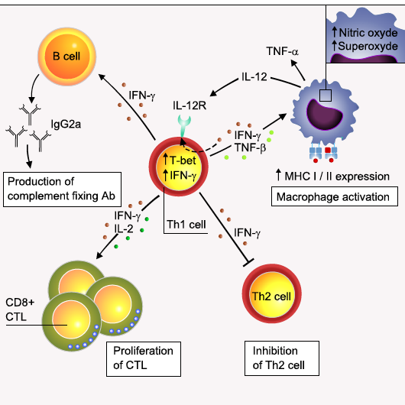
Function of Th1 CD4 T Cells
TH1 cells produce the cytokine interferon-γ (IFN-γ), which
activates phagocytes to kill ingested microbes
stimulates the production of antibody isotypes that promote the phagocytosis/ opsonization of microbes
stimulates the expression of class II MHC molecules and B7 co-stimulators on macrophages and dendritic cells, to amplify T cell responses

Slide 34
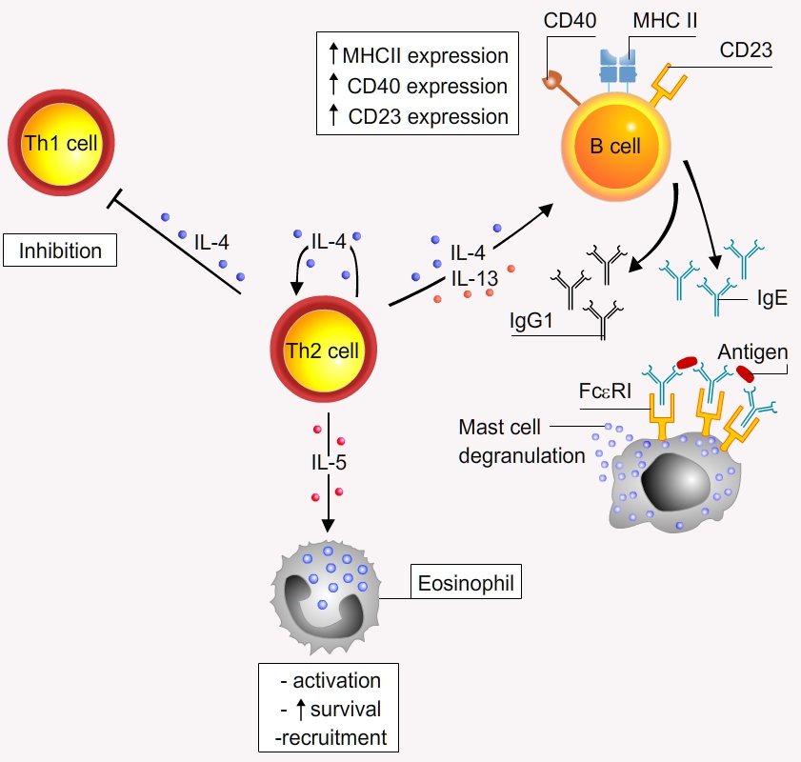
Function of Th2 CD4 T Cells
IL-4 produced by Th2 cells
stimulates the production of IgE and IL-5, which activates eosinophils. IgE activates mast cells and binds to eosinophils, important in killing helminthic parasites.
IL-4 and IL-13 produced by Th2 cells
promote expulsion of parasites from mucosal organs and inhibit the entry of microbes by stimulating mucus secretion.
  IL-13 → mucus production
  IL-4 → smooth muscle contraction
inhibit the microbiocidal activities of macrophages and thus suppress Th1 cell-mediated immunity to balance the activation of Th1 and Th2 cells in response to that microbe.
Allergic reactions are Th2-like reactions in response to allergens that mimic foreign antigens.

Slide 35
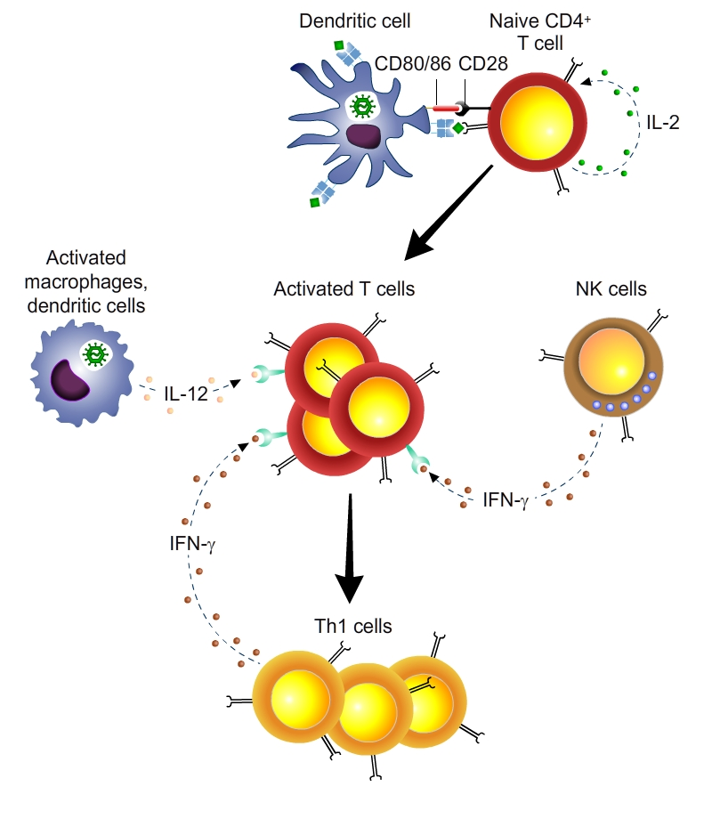
Development of the Th1 subset
Cytokines that induce Th1 development:
IL-12 (and IL-18) produced by microbe-activated dendritic cells and macrophages
IFN-γ made by NK cells or by the responding T cells themselves
Transcription factors involved in Th1 differentiation
T-bet (induced by IFN- γ)
Stat4 (induced by IL-12)

Slide 36
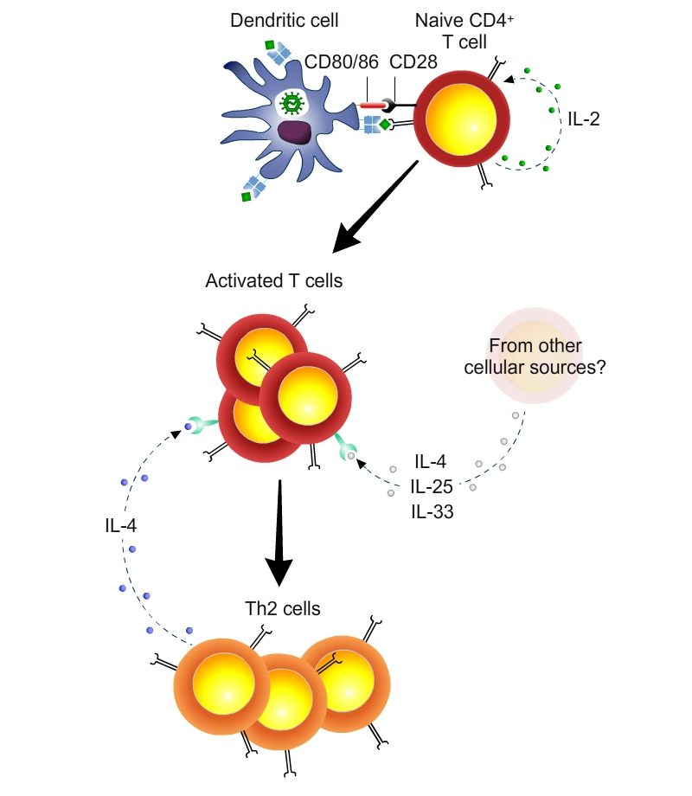
Development of the Th2 subset
The cytokines that induce Th2 cell differentiation:
- IL25 and IL33 produces by barrier epithelia
- IL-4 produced by the T cells themselves in the absence of IL-12
The transcription factors involved in Th2 development are GATA-3 and Stat6 (induced by IL-4).
IL25
IL33

Slide 37
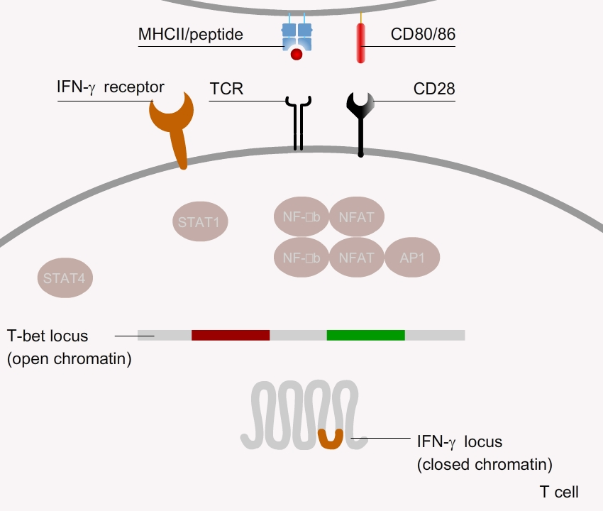
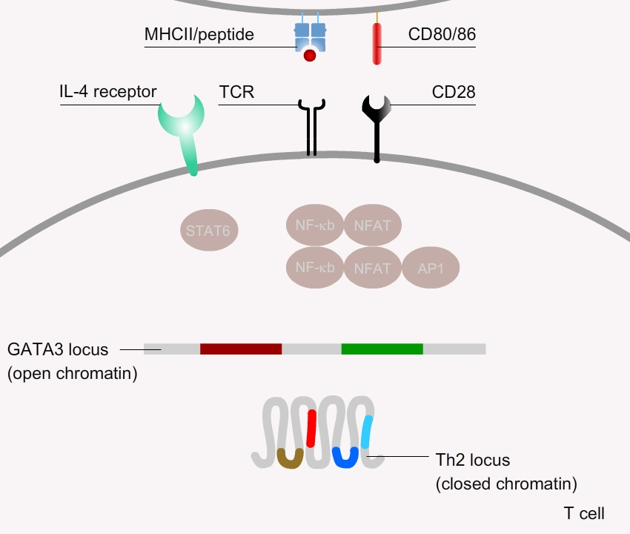
Th1/Th2 signalling pathways
Polarization into Th1 or Th2 phenotypes, which relies on different gene signalling pathways, depends on:
the cytokine microenvironment
interactions with DCs via co-receptors
the nature and concentration of antigen presented.
Th1
Th2

Slide 38
Conclusions | T cell differentiation
CD4 helper T cells differentiate into subsets of effector cells that produce restricted sets of cytokines and perform different functions.
Th1 cells, which produce IFN-γ, activate phagocytes to eliminate ingested microbes, and stimulate the production of opsonizing and complement-binding antibodies.
Th2 cells, which produce IL-4 and IL-5, stimulate IgE production and activate eosinophils, which function mainly in defense against helminths.
Th17 cells, which produce IL-17, are implicated in several inflammatory diseases and may play a role in defense against bacterial infections.
The polarization into various Th is mediated by cytokines and involves epigenetic changes of T cells populations.
Th1 differentiation is induced by IL-12 and IFN-γ and involves the transcription factor T-Bet.
Th2 differentiation is induced by IL-25, IL-33 and IL-4 and involves the transcription factor GATA-3.
Not discussed in the course: Innate lymphoid cells and their polarization

